Slide 1
Family Business Battleground
Surviving and Thriving in your Family Business
Family Business Management

Slide 2

Surviving and Thriving in your Family Business
Family Business can be managed by one member of a family or by multiple members of a family who are employed in the business.

Slide 3
Surviving and Thriving in your Family Business
If all the family members have an equal share it could mean that all members have an equal say in the decisions to be made at the business, as well as an equal share of the profit too.

Slide 4
Surviving and Thriving in your Family Business
In an alternate case it might be that the family member designated as the Managing Director who makes all the business decisions without consulting other members of the family.

Slide 5
Surviving and Thriving in your Family Business
A family run business can have multiple and intricate dimensions to the interpersonal dynamics identical to a public company that can make a huge impact on overall business.

Slide 6
Surviving and Thriving in your Family Business
Good business decisions are sometimes hindered by dynamics of personal and professional issues. If there are unresolved family conflicts they will undoubtedly be carried into the workplace and impact the motivation and productivity of everyone involved.

Slide 7
Surviving and Thriving in your Family Business
Important issues are to be resolved in order to work compatibly together.

Slide 8
Surviving and Thriving in your Family Business
The key elements are: resolving the issues around boundaries, respecting each other’s different skills, and trusting that all of us can do our jobs well.
Secondly, to do the job effectively necessary training can be provided to the family members.

Slide 9
Surviving and Thriving in your Family Business
Crucial elements to resolve conflict between family members in historic patterns of relating between family members is necessary.

Slide 10
Surviving and Thriving in your Family Business
We are habitual while in family business and familiar with our family to take notice of the work patterns of the family members.

Slide 11
Surviving and Thriving in your Family Business
When they start to impact our business they need to be reviewed and changed so as to resolve them.

Slide 12
Family Governance

Slide 13
Introduction
Family Business constitutes world’s oldest and most dominant form of business organization.
Family Businesses range from small and medium sized companies to large conglomerates that operate in multiple industries and countries.
Definition of Family Business:
A family business refers to a company where the voting majority is in the hands of the controlling family; including the founder(s) who intend to pass the business on to their descendants.

Slide 14
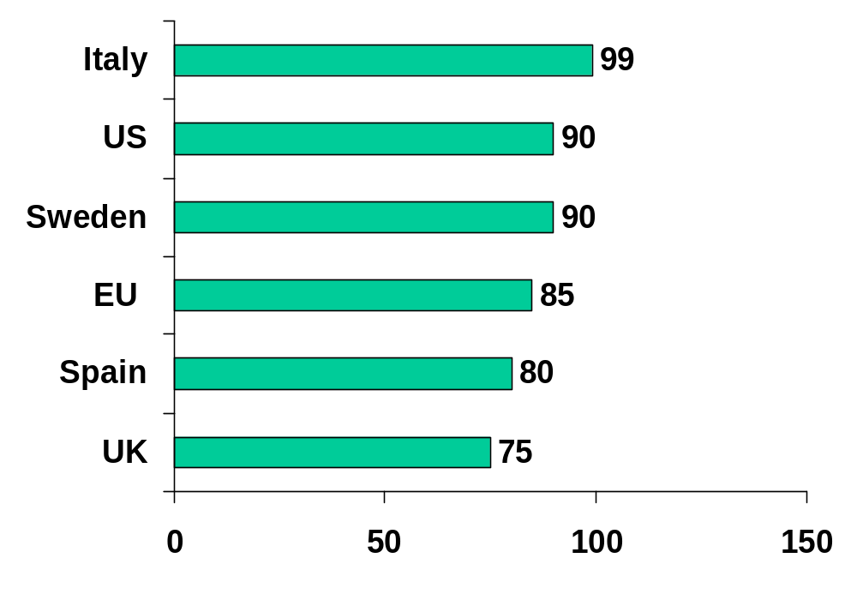
The Importance of Family Business—and Hence Corporate Governance—to the Economy
Proportion of OECD Firms That are Family-Run
In percent
Over 85% of EU/US businesses are family run
Source: Nancy Upton and William Petty, “Venture Capital Investment in Family Business,” Venture Capital, 2000, Vol. 2, No. 1, pp. 27-39

Slide 15
Strengths of Family Business
They outperform non-family owned companies in sales, profit, and other growth measures.
Thomson Financial study compared family firms to rivals on the six major indexes in Europe and showed that family companies outperformed their rivals on all of these indexes (2003).
Strengths:
High commitment/dedication from family as business owners.
Family members willingness to work harder and reinvest profits into the business for long term growth.
Willingness to pass on knowledge and experience
Family name and pride associated with the business.

Slide 16
Weaknesses of Family Business
Two-thirds to three-quarters collapse or are sold by the founders during their own tenure.
Family Businesses have short life span. 95% do not survive third generation of ownership.¹
Weaknesses:
Poor Management, insufficient cash to fund growth.
Non-alignment of incentives among family members.
Lack of articulated practices and procedures.
Lack of discipline.

Slide 17
Stages of Family Business and Common Issues
Ownership Stage | Dominant Shareholder issues
Stage 1: The Founder(s) | - Leadership transition - Succession - Estate planning
Stage 2: The Sibling Partnership | -Maintaining teamwork and harmony -Sustaining family ownership -Succession
Stage 3: The Cousin Confederation | - Allocation of corporate capital: dividends, debt, and profit levels - Shareholder liquidity - Family conflict resolution - Family participation and role - Family vision and mission - Family linkage with the business
Notes:
-

Slide 18
Overlapping Roles and Responsibilities of Family Members
Family
member
Manager
Owner
Director
Notes:
Many family businesses find it useful to develop family governance structures (e.g. family assembly, family council) which are parallel to the business governance structures (i.e. shareholders assembly, board) to address issues and interests of the family as a whole.
A family governance structure could take the form of a family assembly which has all family members meeting annually to update each other on how the business is going, discuss certain issues, and get the opinions of those not formally involved in the governance of the business. Since all family members would be invited it should be structured so that there are events for all age groups. Such an event can also be an opportunity for education, recreation, and emphasizing the family business culture.
In addition, there may be a family council which acts as an executive committee of the family assembly. It would be comprised of between five and nine elected members representing different branches and age groups in the family, and including both members who are employed in the business and those who are not. It would meet as often as necessary to address particular issues and interests in a semi-formal manner.
As a family grows into further generations (in the future, for Wadi Holdings), certain committees can be added to the family governance structure to address particular issues such as philanthropy, career planning of family members, education, and development of family members.
One of the issues which a family council may want to address is taking the lead in drafting a family constitution, or other governance documents such as a family business protocol or simply a family mission statement. The family constitution is the most comprehensive type of family governance document and commonly covers the family’s values and beliefs (mission statement), and family business principles or policies (on employment, ownership, business governance, family governance, conduct in the business and outside, the means of amending the constitution [e.g. majority voting]). Such a document should be periodically revised to reflect the changing requirements of an evolving business and family. The process of drafting such a document is as important as its content. The family as a whole should feel involved in the process and have time to reflect on it and agree to it.
The Wadi family will decide what family governance structure and document suits it best. Such a parallel governance structure to the business can provide a useful framework for consultation between the business and the family. It will become increasingly important for everyone that, as the family group increases and individual shareholdings decrease, a well-functioning structure is in place to inform and consult with the family.

Slide 19
How Can Good Family Governance Help?
Well-Functioning Family Governance Structures aim at:
Communicating the family values, mission, and long term vision to all family members.
Keeping family members (especially non-executives) informed about major business accomplishments, challenges, and strategic directions.
Communicating the rules and decisions that might affect family members’ employment, dividends, and other benefits they usually get from the business.
Establishing formal communication channels that allow family members to share their ideas, aspirations and issues.
Allowing the family to come together and make any necessary decisions.

Slide 20
Family Institutions
Family institutions can have different forms and purposes
Family Assembly: A formal forum to discuss all business and family issues.
Family Council: it is the governance body for the assembly in coordinating the family members interest in the business.
Family Office: It is an investment and administrative center that is organized and overseen by the family council.

Slide 21
Family Constitution
Family Constitution helps formally codify many of the family governance structures. Typically defines:
Family values, mission statement, and vision.
Family institutions, including the family assembly, the family council, the education committee, the family office, etc.
Board of directors (and board of advisors if one exists).
Senior management.
Authority, responsibility, and relationship among the family, the board, and the senior management.
Key Family Governance Policies (see next)

Slide 22
Key Family Governance Policies
Family Employment Policy: Policies should not discriminate or favor family members. Must establish atmosphere of fairness and motivation for all employees.
Family Shareholding Policy: Establishes rules for share ownership and transfer to ensure shares are kept in the family when desired (e.g., Share Redemption Fund).
Family Dividend Policy: Establishes guiding principles for family dividend payments to help resolve differing family cash demands.
Family Director Nomination Policy: Guidelines for electing family members to the company Board of Directors.
Family Education Policy: Guidelines for helping family members gain educational and professional training (may include Education fund).
Conflict Resolution Policy (and Committee): Describes measures to help resolve conflicts between family members within a defined scope.

Slide 23
Putting ‘Business First’
Sample Issues | Family First Cos.
Family Employment | Open-Door Policy for all family members, regardless of qualifications
Compensation | Equal pay for all, regardless of their experience or performance
Leadership | Leadership based on Seniority in Family, regardless of merit or qualifications
Resource Allocation | Business Resources used for personal needs (e.g., loans, grants)
Decision-Making | Unilateral & Concentrated with Senior Family Member (e.g., Chairman/CEO)
Business First Cos.
Qualification-Based Employment, as for any other new hire
Merit-Based pay, based on experience, performance
Leadership granted to the right person (family or non-family), based on merit and qualifications
Business resources only used for business purposes – separate family reserve fund utilized for family needs.
Mulit-lateral, based on Defined Governance Structure (e.g., Executive Committee)
Notes:
IFC Family Governance Handbook

Slide 24
Board of Directors – Key Considerations
The Board of Directors is the central institution in the governance of family-owned business.
Initial stage of the board is only to comply with the legal requirements but as the business grows.
As interim step, many family cos. consider Advisory Board that complements the skills and qualifications of their current directors.
Ultimately, the board must transform for long-term sustainability. For example:
Move to a full professional board with outside members.
Clearly define the roles of the board and separation between family institutions and senior management.
Ensure Board has full autonomy to direct and control the organization, separate from family influence.

Slide 25
Independent Directors
Once family business size grows, then it is important to establish an independent board.
Normally, board membership is given to family members and few trusted non-family members.
Independent directors
        Bring outside perspective on strategy and control.
        Add new skills and knowledge to the firm.
        Independent hiring decisions can be made.
        They have an objective ear to disagreements in the among family-member managers.
        They can use their connections to the advantage of the business.

Slide 26
Senior Management – Key Considerations
Senior managers are an integral part of family governance structure.
They manage the day to day operations of the business and the direction that is set out by the board of directors.
The founder(s) initially manage the family business but as it grows in size a formal management structure is required.
Ultimately, Senior Mgt must transform for long-term sustainability. For example:
Ensure that the right senior managers are in place.
Decision-making processes are not unilateral (e.g., only Family CEO/Chairman) – consider Executive Committee
Remuneration system based solely on performance
Evaluations of Senior Executives conducted fairly and objectively

Slide 27
Advisory Boards
Advantages | Disadvantages
-Easy to recruit since members have no legal responsibilities -Provides company with additional skills, technical expertise and knowledge. -Advice is usually unbiased -Members may offer new contacts leading to sales or source of capital. | -Advice may not be followed by the company. -No authority to request information from the company. -No influence over strategy and performance oversight of the management. -Cannot be held accountable for their advice. -May not take their role seriously.

Slide 28
Senior Management Succession
Most important issue for family-owned business is Senior Management Succession plan.
Poor senior management succession is the main reason why family businesses collapse before they reach the third generation.
Formal succession plan should allow selection of the most competent person (whether it is a family member or not).
Family members must be involved in the selection process as also the board, key senior managers, and other important external stakeholders and they all must agree on the choice.

Slide 29
Steps of a Formal Succession Plan
Starting Early
        To ensure continuity of business, it is important when current CEO is appointed, plans for the next one should start.
Create Career Development systems
        Consider strategic direction of company and what executive skills will be needed
        Create development systems to help executives fill skills gaps
Seeking advice
        External independent directors or senior non-family members should be consulted on the choice.
Building Consensus
        Mandatory to involve key stakeholders in the selection process.
Clarifying the transition process
        A transition plan must be developed between the current CEO and the successor. The process should specify the transition date and also the level of involvement of current CEO after retirement

Slide 30
Conclusion
The inherent challenges of family businesses can be mitigated by adopting a sound corporate governance structure.
The corporate governance structure must clearly define the roles, responsibilities, rights, and interaction between the companies main governing bodies.
In a family, corporate governance responsibility is shared among owners, board of directors, and senior management.
Setting-up a corporate governance structure early will help anticipate and resolve conflicts among family members about business issues.
Families must set-up adequate structure for the board of directors and senior management.
A clear governance structure will make it easier to maintain family cohesion and its members’ interest in the family and business and ensure long-term sustainability!

Slide 31
6 Strategies for Successful Family Business Planning

Slide 32
Why are YOU so important?
95% of businesses in the US today are family-owned or closely-held.
80% of those businesses have 20 or fewer employees.
However, these businesses are responsible for contributing over 45% of our GNP (Gross National Product)!

Slide 33
So, you…
generate more new products;
create more new jobs;
and contribute more to your local communities…
  than your corporate counterparts!
  But, it’s not easy…

Slide 34
However, business transition is one of our greatest challenges…
65%...
The number of business that will transition ownership or leadership within the next 5 years…

Slide 35
Business Development Cycle
Comfort
Hard work
Liquidation
Almost 35% sell or liquidate – often failing to realize their intended value.
Growth
Time
Wonder Blunder Thunder Plunder/Wonder

Slide 36

Reality Check:
85% of American Business Owners state:
“I want to pass this business on to the next generation”
Sadly, fewer than half have the opportunity to do so…

Slide 37
Change with Dignity
A successful, well planned transition will provide opportunities for enrichment and joy and the chance to change the course of one’s life with dignity.

Slide 38
Consider Your Exit
Strategy
When might you like to step away from this business?
What will this business need to do for you – to enable you and your family to realize your future vision?

Slide 39
Retirement is NOT a requirement!
Do you have hobbies outside of work?
Are your closest friends people at work?
Do you enjoy getting up and going to work?

Slide 40
Money isn’t Everything!
“Money can add pleasure in people’s lives but it won’t bring the happiness that comes with self-respect, accomplishment and satisfaction.” - Dr. Edward Diener

Slide 41
"You always say 'I'll quit when I start to slide,' and then one morning you wake up and realize you've done slid"!
~ Sugar Ray Robinson, 1965

Slide 42
Exit by Design…
What is it worth today?
What do you want it to be worth tomorrow?
Can it run without you?
Who might want it in the future?

Slide 43
Define Your Vision and Develop the Plan
WHAT do you want your business to look like in 3 to 5 years?
- Growth, sustainability, increased
value?
Keep it simple!

Slide 44
Integrated Planning
Family Needs
Business Needs
Strategic Planning

Slide 45
The Basic Steps to Develop Your Plan
Imagine your business in 3 years.
Undertake a SWOT
Consider your Exit Strategies and Desired Value
Develop Goals and Objectives that will drive behavior and create change.

Slide 46
Succession Planning
Succession means planning for the long-term success of your business – not just finding a buyer or replacing one person.
What skills do you need on your team?
Can they be taught or not?
Leaders need to change from managers to mentors
Start early!

Slide 47
Remember:
Managerial ability is more important than birthright.

Slide 48
Estate and Financial Planning
Protect your assets – explore the use of trusts with your estate planner.
What do you REALLY need?
Fair vs Equal

Slide 49
Estate and Financial Planning continued…
Estate planning attorneys - experience with business?
Make sure your ‘experts’ work together.
You have options – but you NEED time…

Slide 50
Build an Advisory Board
Identify skill gaps
Invite subject matter experts
1 year term
Define expectations and compensation
Listen to the advice!

Slide 51
Develop Policies to Support Success
Deal with emotional issues before emotion becomes the issue.
Identify spoken and unspoken rules.
Develop policies that will help your successors to manage expectations, performance and relationships more effectively.

Slide 52
Help is available…
If developing policies and procedures is difficult, locate advisors who can assist you. Sometimes, simply having a neutral voice in the room can move the conversation forward.

Slide 53
Business Development Cycle
Comfort
Hard work
Liquidation
Re-create wonder for the next generation of owners!
Growth
Time
Wonder Blunder Thunder Plunder/Wonder

Slide 54
Conclusion
Family or closely-held businesses will endure or die depending upon how effectively they plan for the future. Those who survive will have managed to re-create the energy and wonder that fueled the original entrepreneurial spirit.

